Slide 1
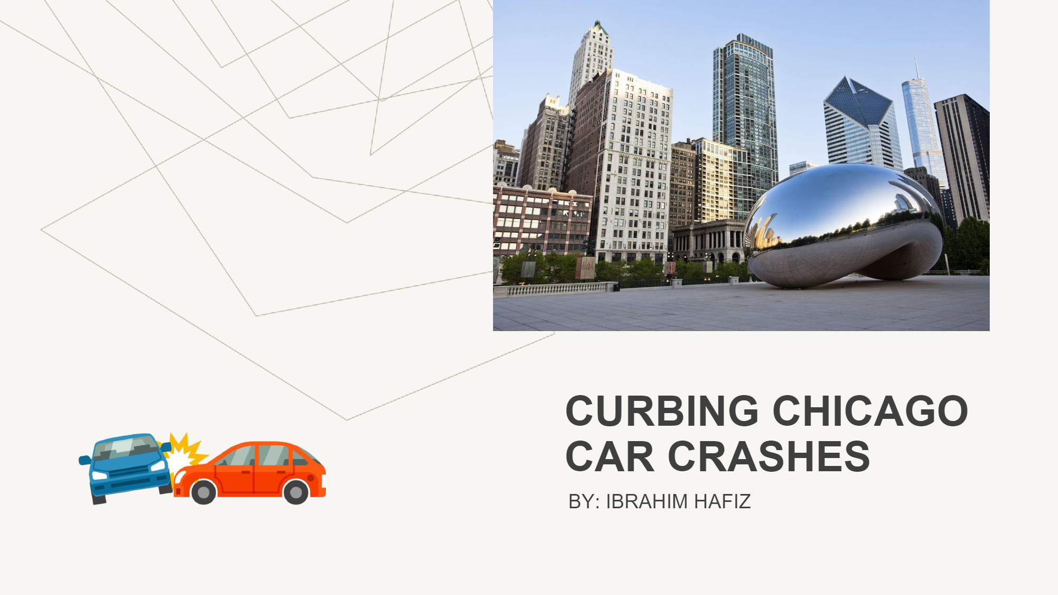
CHICAGO CAR CRASH ANALYSIS
BY: IBRAHIM HAFIZ

Slide 2


Slide 3

Business Understanding
The Vehicle Safety Board of Chicago is launching a campaign to reduce the number of car crashes in the city. Our goal is to provide a data lead solutions and insights that will help the Vehicle Safety board allocate funds and target specific areas which will help reduce the number of car accidents.

Slide 4
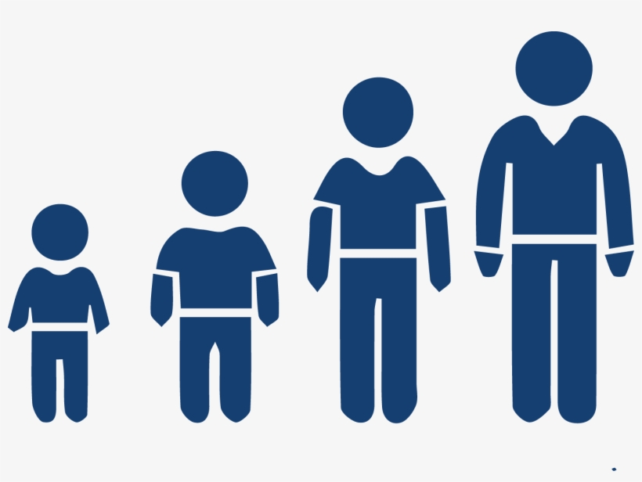
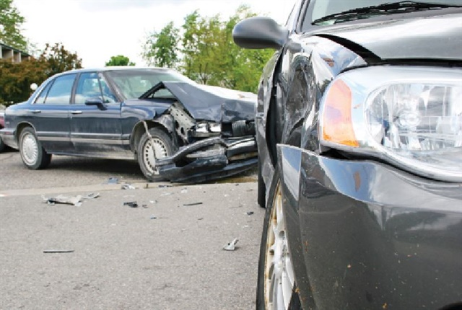
What is Our Focus
Finding the age group that most accidents occur Understanding whether the
accidents were preventable or not

Slide 5


Data Understanding
- The data we had was majorly numerical. We labeled ‘Preventable’ as crashes that could have easily been avoided.
- Not following traffic laws and negligent driving would fall under this category as well.
- ‘Less Preventable’ are crashes that would require a substantial amount of money, time, and labor to fix. Bad road conditions, vision obscurity, and bad weather conditions would fall under this category as well.

Slide 6
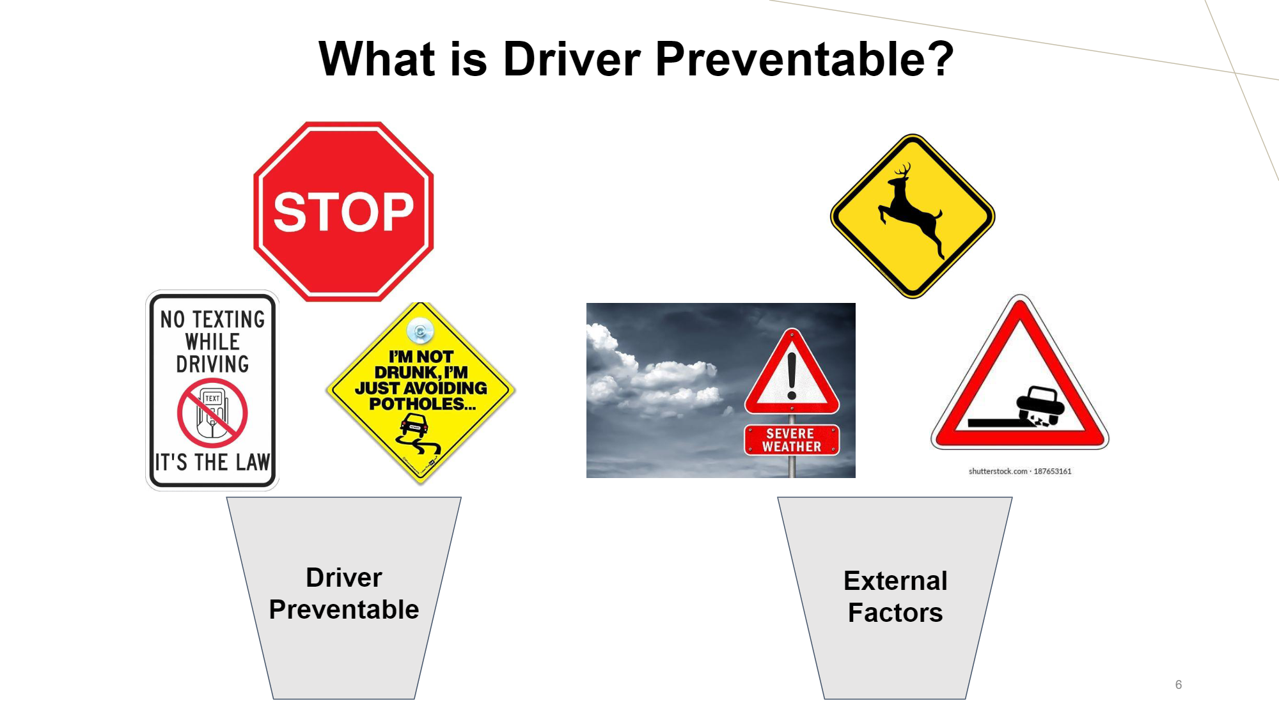

Slide 7
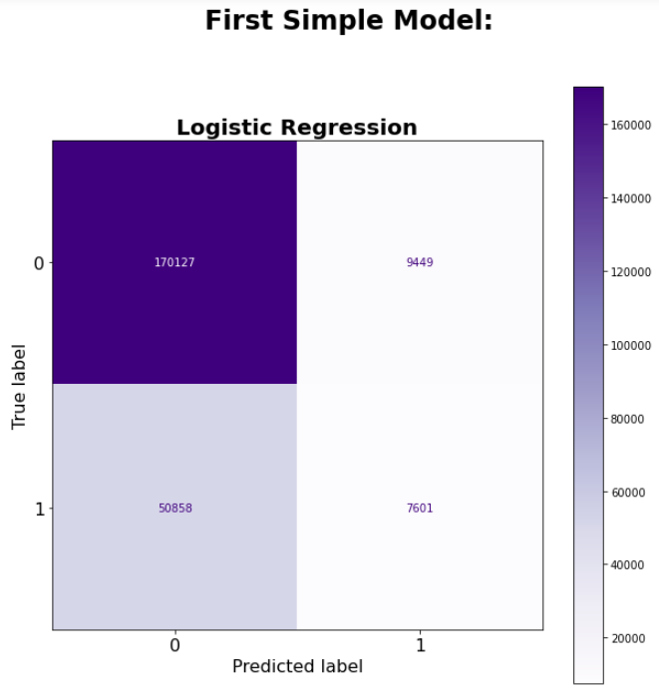
First Model: Logistic Regression
In our first model we used a logistic regression model.
We graded this model on an accuracy score and it resulted in 74% which is our lowest score. Therefore we will use it as our baseline model.
We also graded this model on a precision and got a result of 45%

Slide 8
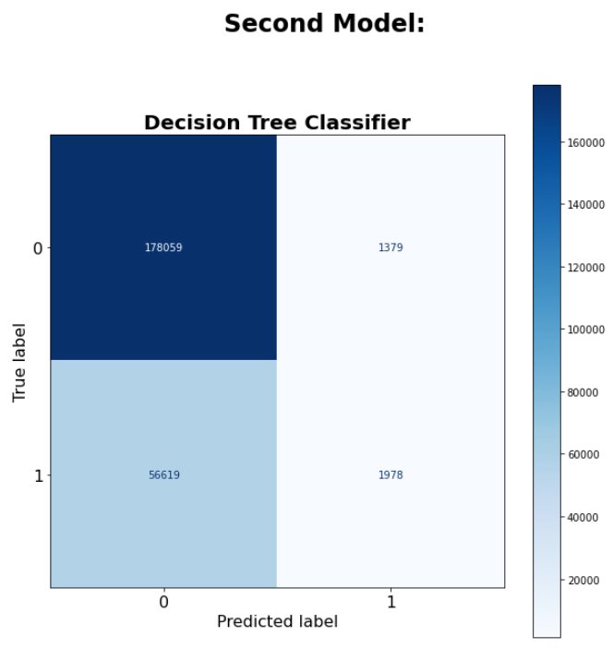
Second Model: Decision Tree Classifier
In our second model the score improved slightly. We found out that bad road condition, obscure driver vision and driver errors were the most important features to consider in our model because those were the aspects heavily linked with car crashes.
The accuracy of the second model was at 75% and the precision improved to 63%.

Slide 9
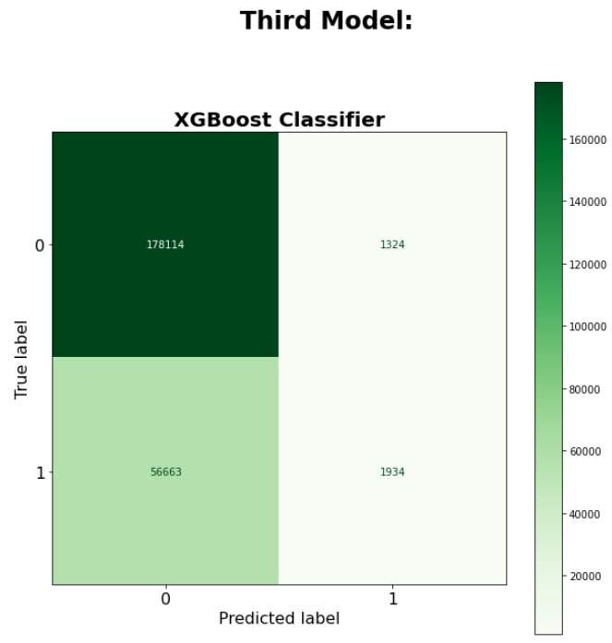
Third Model
For our third model we compared the two previous models to find the model that performed the best. The best performing model was the second model with an accuracy score of 75% and precision of 63%.
The results of our final model indicate that most of the crashes were preventable.

Slide 10
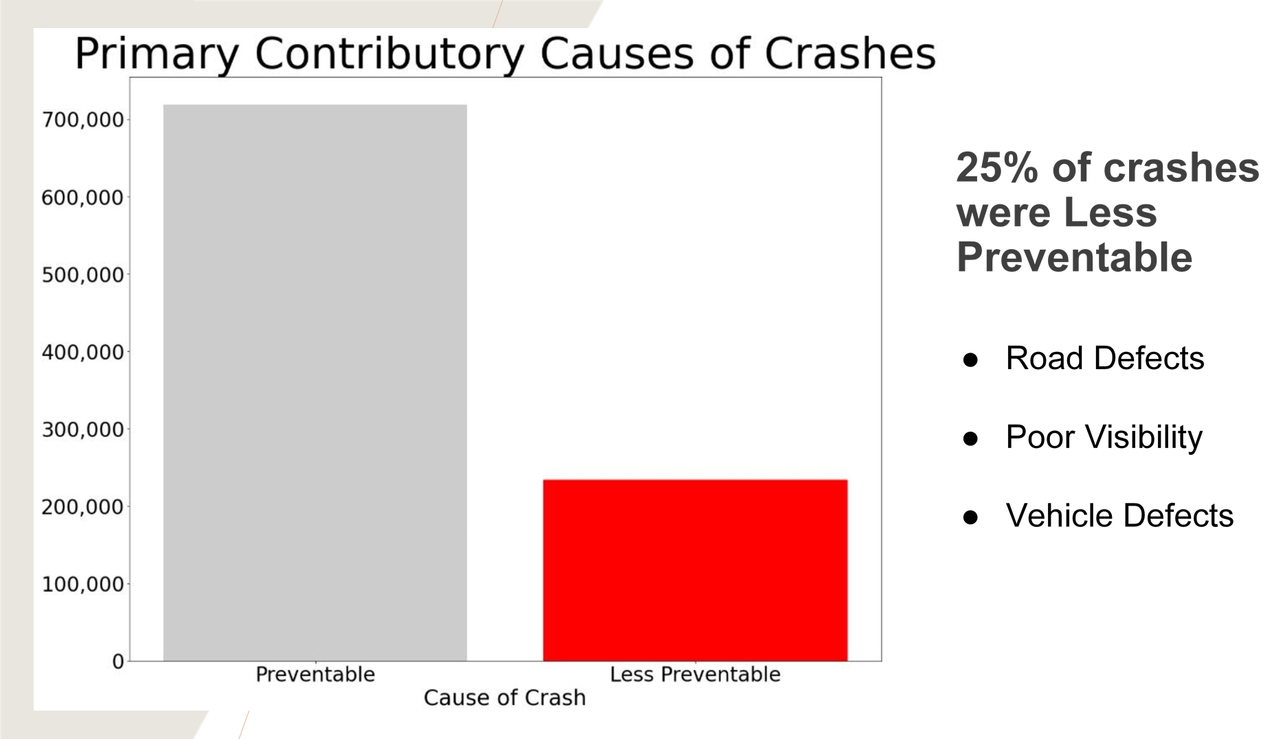

Slide 11
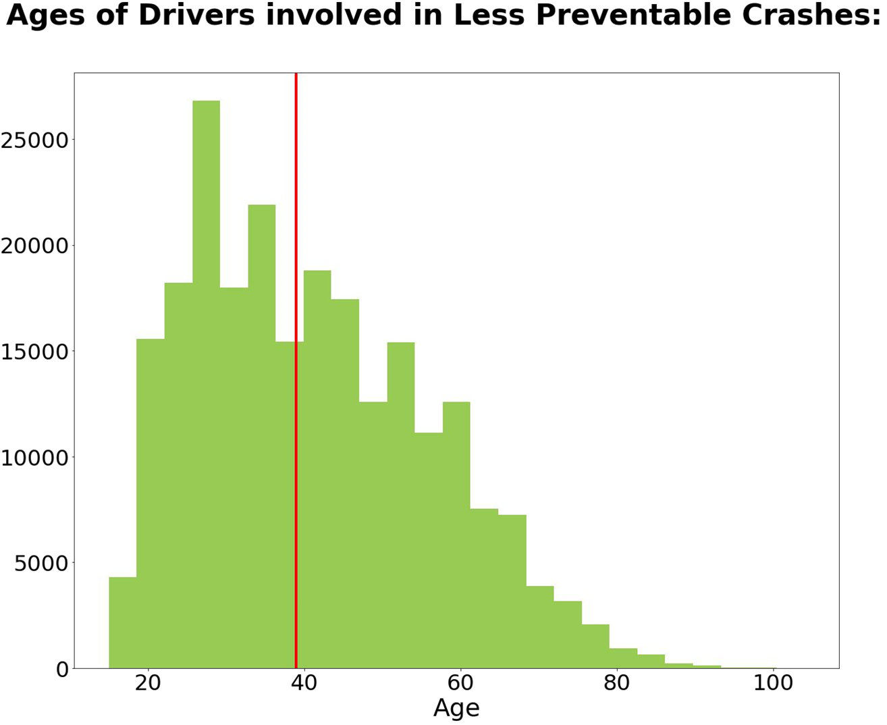
AGE GROUP LIKELY TO BE INVOLVED IN A CRASH
- From our histogram we viewed that the age group that were majorly involved in car crashes were from the ages of between 20-39 years.
- The histogram also tells us that from the age of 40 there is a gradual decrease in the number of car crashes after the age of 40 years.

Slide 12
Recommendations
1. We recommend driver education campaign targeting a younger audience from the age of 20-39. From our analysis this age group largely contributed to ‘preventable’ causes of accidents.
2. For the less Preventable cause which compromised 25% of crashes, we would recommend fixing the road defects which was the major contribution of crashes.
3. We would also suggest efforts to be focused on the Northern part of the city because crashes were more likely to occur there.
4. Lastly, we would recommend to target specific hotspots that are known to be crash magnet areas.

Slide 13
Conclusion
From our analysis we have concluded that 75% of the crashes in Chicago city were very much preventable and preventative measure can be taken to avoid crashes in the future our recommendations based on our analysis were driver education campaign for younger audiences ages of between 20-39 and fixing of defected road in the city which contributed to crashes as well.
Funds and efforts should be prioritized to those areas based on our analysis and predictive models.

